Slide 1
Linear Regression

Slide 2
Regression
Regression analysis is a statistical method to model the relationship between a dependent (target) and independent (predictor) variables with one or more independent variables.
Regression analysis helps us to understand how the value of the dependent variable is changing corresponding to an independent variable when other independent variables are held fixed.
It predicts continuous/real values such as temperature, age, salary, price, etc.

Slide 3
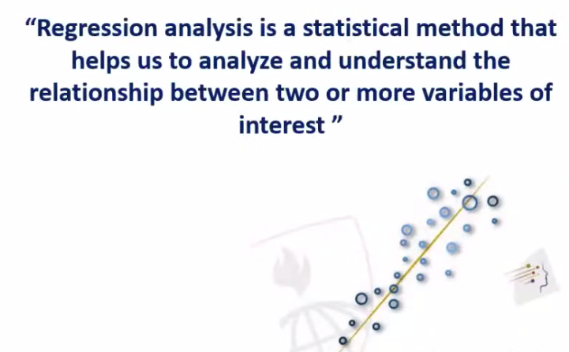
Regression

Slide 4
Regression
Regression is a supervised learning technique which helps in finding the correlation between variables and enables us to predict the continuous output variable based on the one or more predictor variables.
It is mainly used for prediction, forecasting, time series modeling, and determining the causal-effect relationship between variables.

Slide 5
Regression
"Regression shows a line or curve that passes through all the datapoints on target-predictor graph in such a way that the vertical distance between the datapoints and the regression line is minimum."

Slide 6
Terminologies Related to the Regression
Dependent Variable: The main factor in Regression analysis which we want to predict or understand is called the dependent variable. It is also called target variable.
Independent Variable: The factors which affect the dependent variables or which are used to predict the values of the dependent variables are called independent variable, also called as a predictor.

Slide 7
Terminologies Related to the Regression
Outliers: Outlier is an observation which contains either very low value or very high value in comparison to other observed values. An outlier may hamper the result, so it should be avoided.
Multicollinearity: If the independent variables are highly correlated with each other than other variables, then such condition is called Multicollinearity. It should not be present in the dataset, because it creates problem while ranking the most affecting variable.

Slide 8
Terminologies Related to the Regression
Underfitting and Overfitting: If our algorithm works well with the training dataset but not well with test dataset, then such problem is called Overfitting. And if our algorithm does not perform well even with training dataset, then such problem is called underfitting.

Slide 9
Why do we use Regression?
Regression estimates the relationship between the target and the independent variable.
It is used to find the trends in data.
It helps to predict real/continuous values.
By performing the regression, we can confidently determine the most important factor, the least important factor, and how each factor is affecting the other factors.

Slide 10
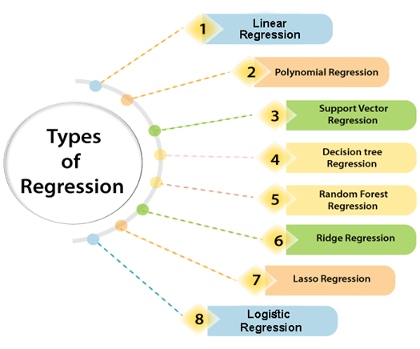
Types of Regression

Slide 11
Linear Regression
Linear regression is a statistical regression method which is used for predictive analysis.
It is one of the very simple and easy algorithms which works on regression and shows the relationship between the continuous variables.
It is used for solving the regression problem in machine learning.
Linear regression shows the linear relationship between the independent variable (X-axis) and the dependent variable (Y-axis), hence called linear regression.
If there is only one input variable (x), then such linear regression is called simple linear regression. And if there is more than one input variable, then such linear regression is called multiple linear regression.
The relationship between variables in the linear regression model can be explained using the below image. Here we are predicting the salary of an employee on the basis of the year of experience.

Slide 12
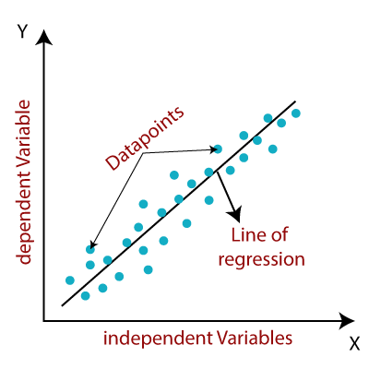
Linear Regression

Slide 13
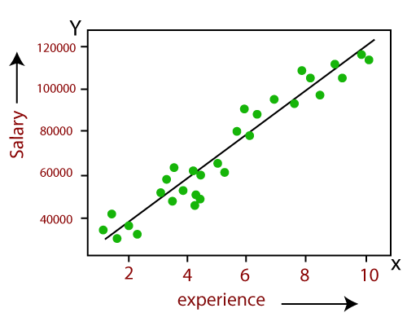
Linear Regression
The mathematical equation for Linear regression:
Y= aX+b
Here, Y = dependent variables (target variables), X= Independent variables (predictor variables), a and b are the linear coefficients

Slide 14
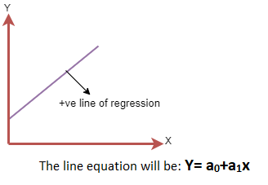
Linear Regression Line
A linear line showing the relationship between the dependent and independent variables is called a regression line. A regression line can show two types of relationship:
Positive Linear Relationship:
If the dependent variable increases on the Y-axis and independent variable increases on X-axis, then such a relationship is termed as a Positive linear relationship.

Slide 15
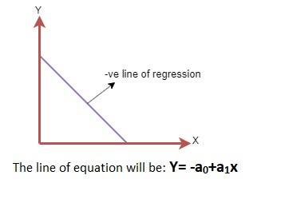
Linear Regression Line
Negative Linear Relationship:
If the dependent variable decreases on the Y-axis and independent variable increases on the X-axis, then such a relationship is called a negative linear relationship.

Slide 16
Finding The Best Fit Line
When working with linear regression, our main goal is to find the best fit line that means the error between predicted values and actual values should be minimized. The best fit line will have the least error.
The different values for weights or the coefficient of lines (a₀, a₁) gives a different line of regression, so we need to calculate the best values for a₀ and a₁ to find the best fit line, so to calculate this we use cost function.

Slide 17
Finding The Best Fit Line
Cost function-
The different values for weights or coefficient of lines (a₀, a₁) gives the different line of regression, and the cost function is used to estimate the values of the coefficient for the best fit line.
Cost function optimizes the regression coefficients or weights. It measures how a linear regression model is performing.
We can use the cost function to find the accuracy of the mapping function, which maps the input variable to the output variable.

Slide 18

Finding The Best Fit Line
Cost function-
For Linear Regression, we use the Mean Squared Error (MSE) cost function, which is the average of squared error occurred between the predicted values and actual values. It can be written as:
Where,
N=Total number of observation Yi = Actual value (a1x_{i}+a₀)= Predicted value.

Slide 19
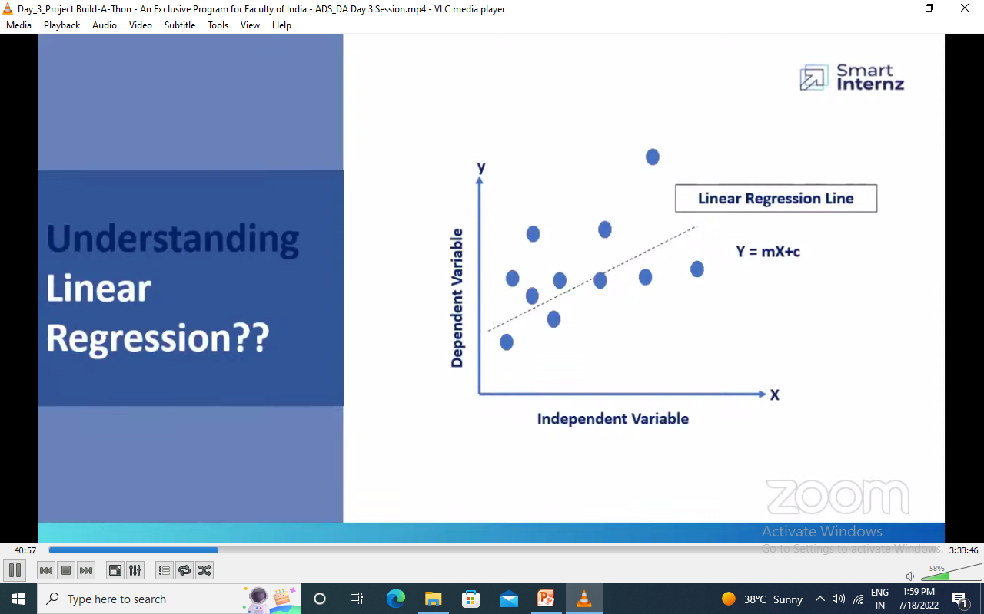
Mathematical Implementation of Linear Regression

Slide 20
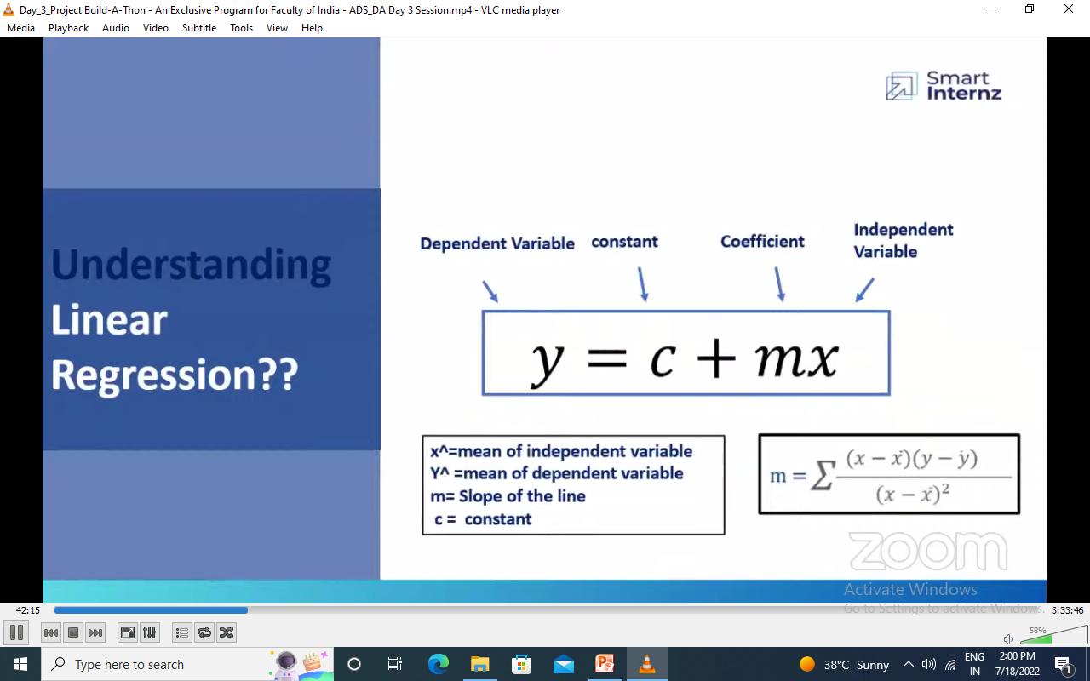
Mathematical Implementation of Linear Regression

Slide 21
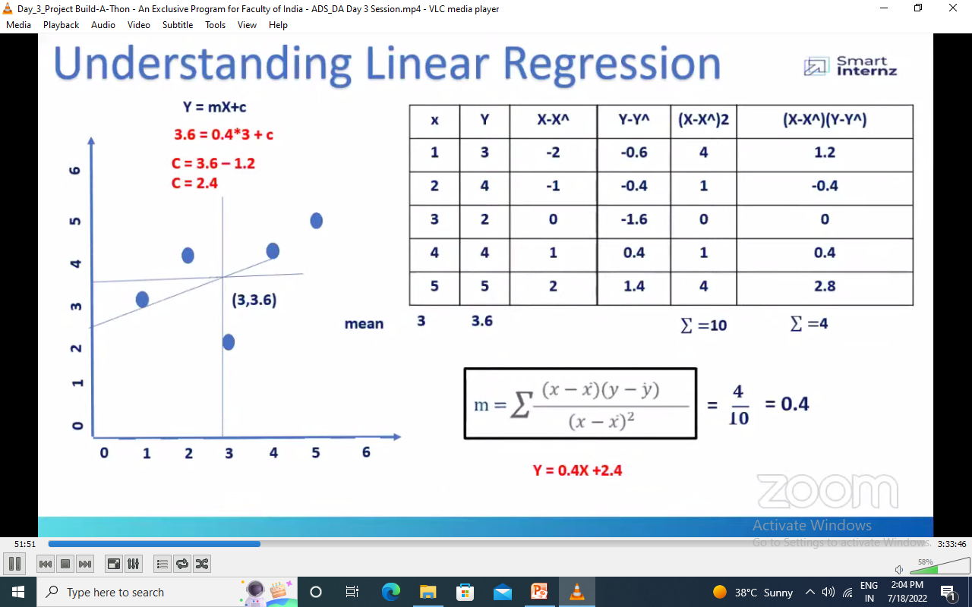
Mathematical Implementation of Linear Regression

Slide 22
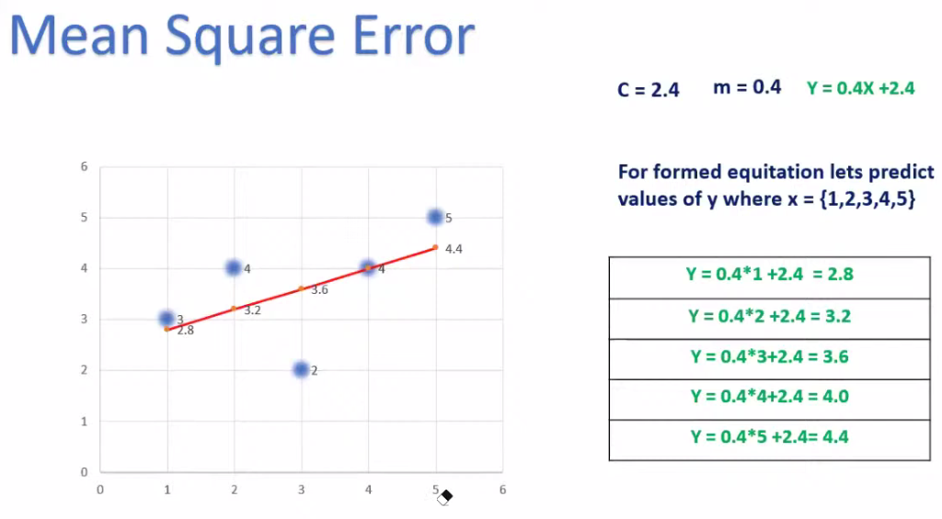
Mathematical Implementation of Linear Regression

Slide 23
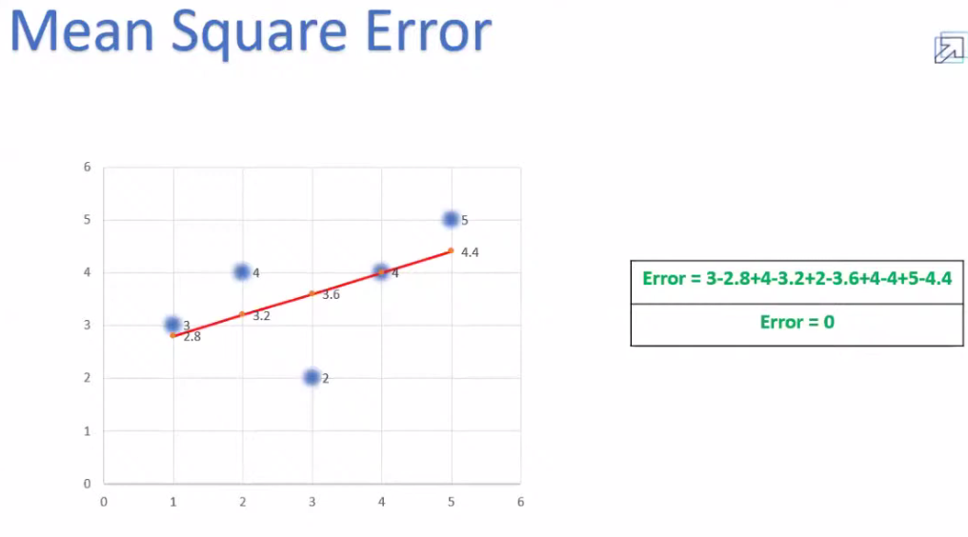
Mathematical Implementation of Linear Regression

Slide 24
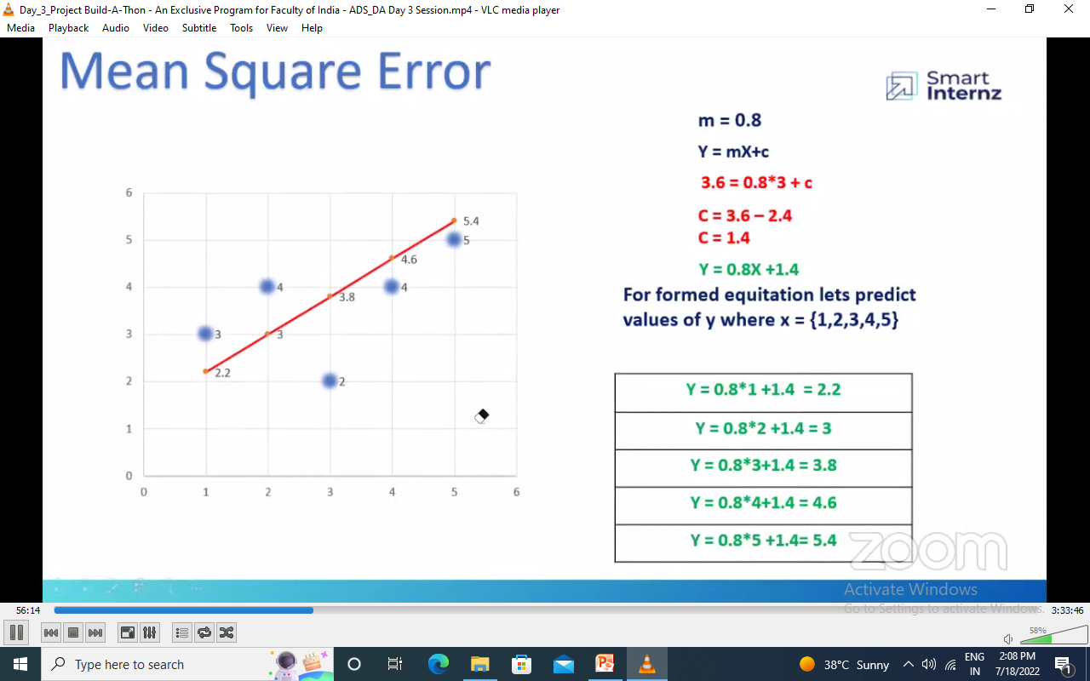
Mathematical Implementation of Linear Regression

Slide 25
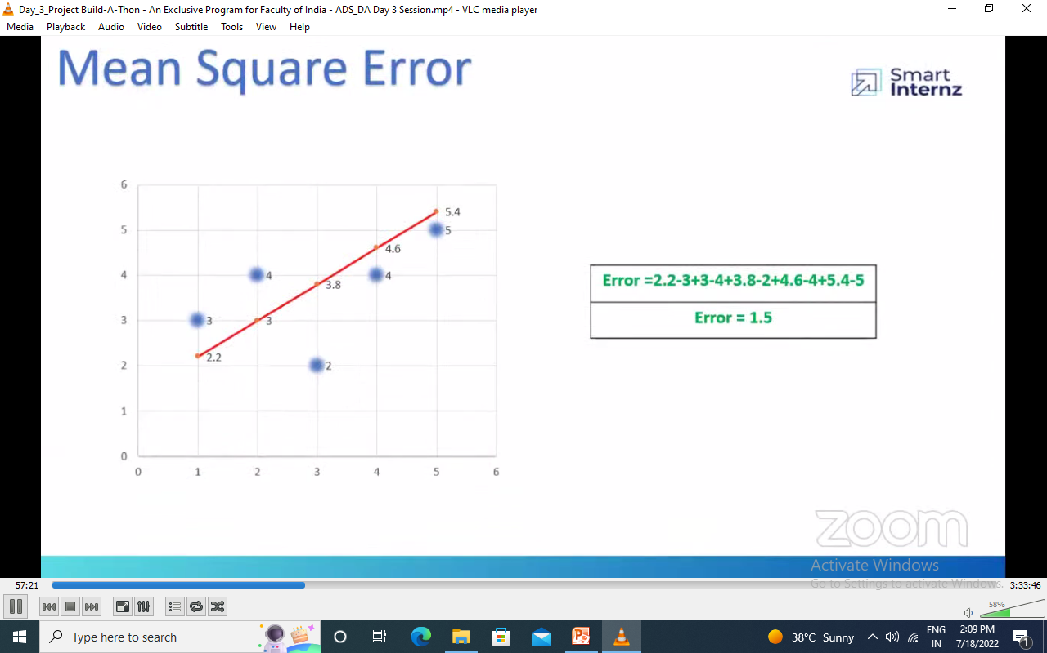
Mathematical Implementation of Linear Regression

Slide 26
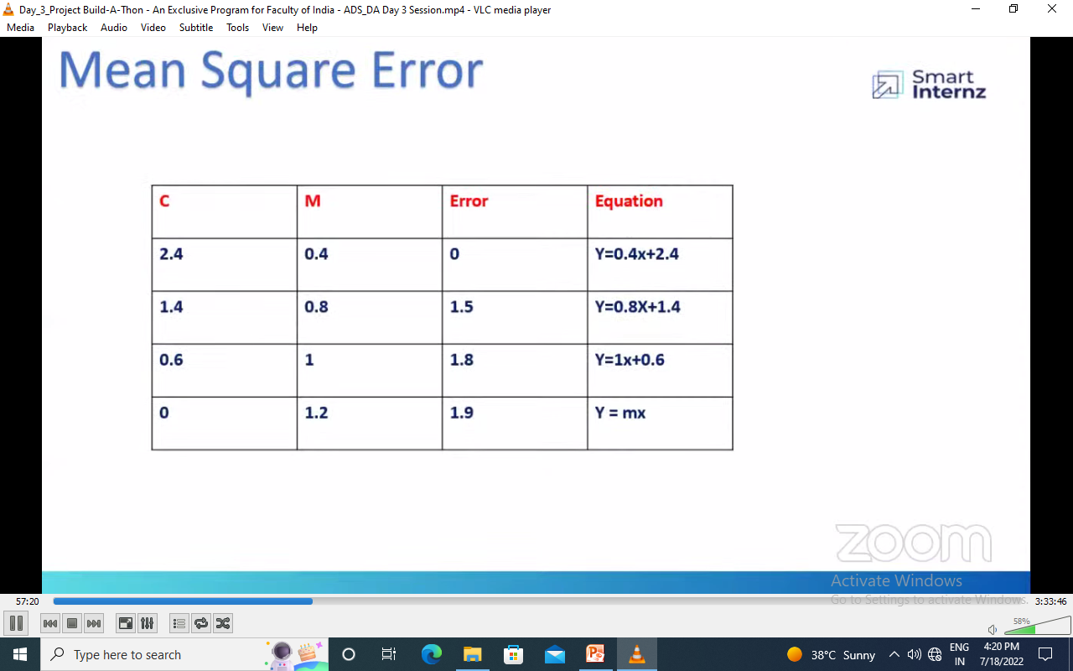
Mathematical Implementation of Linear Regression

Slide 27
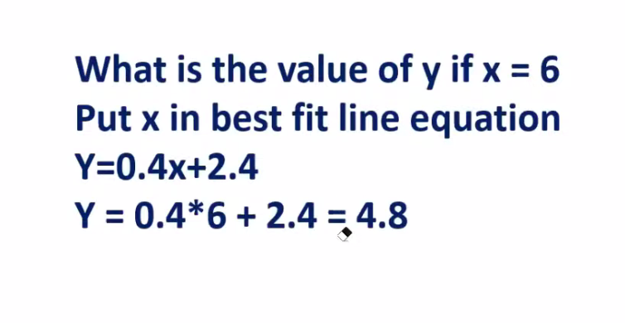
Mathematical Implementation of Linear Regression

Slide 28
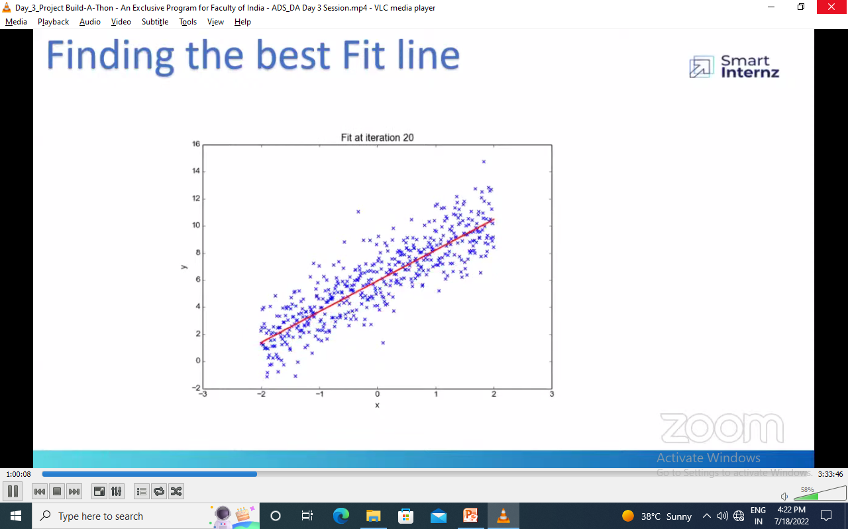
Mathematical Implementation of Linear Regression

Slide 29
References
https://www.javatpoint.com/regression-analysis-in-machine-learning

